Slide 1
Data-driven electrolyte design for lithium metal anodes
CME 502 Mathematical analysis and modeling
Shuo Xu
4-30-2024

Slide 2
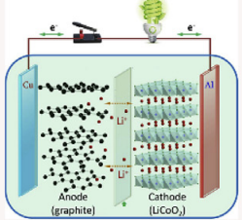
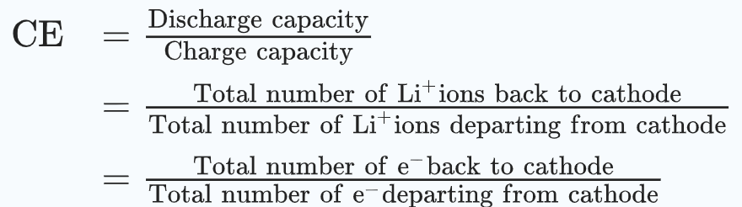
Background general
Past study on lithium metal anode batteries shows electrolyte engineering greatly improve cycling Coulombic efficiency
In rocking-chair battery CE is a measurement of capacity retention, as total lithium ion is fixed. In lithium metal anode, CE can be an indicator of forming better Solid Electrolyte Interface(decomposed electrolyte at anode surface) but not necessary. Still, it can used to compare electrolyte property at low potential.
Huang F. et al push CE to 99.2% average for 300 cycles, and many study have CE 99.5% for 10-40 cycles
Goal: find an electrolyte formula for higher CE using ML regression model (like a more rigorous curve fitting and interpolate extrapolate method)
Process data from past study and find different factors relation with CE and which factor is more important, so they may have some insights for factors influencing CE

Slide 3
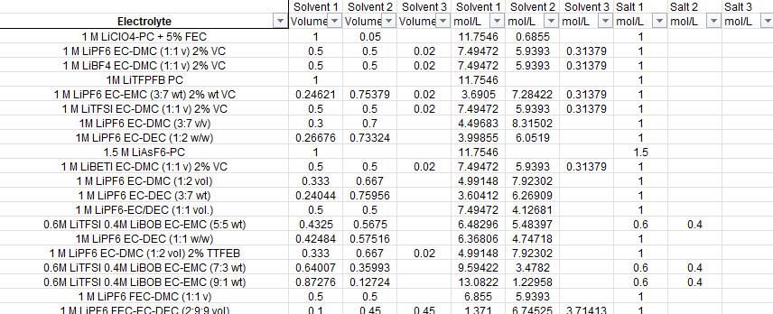

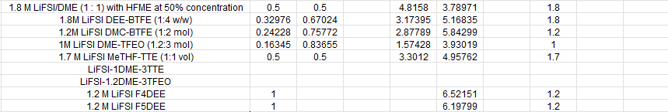

Background dataset
150 sets of data with different electrolyte formula and CE for Li|Cu cystem

Slide 4
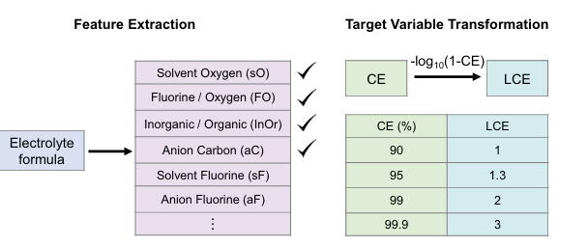
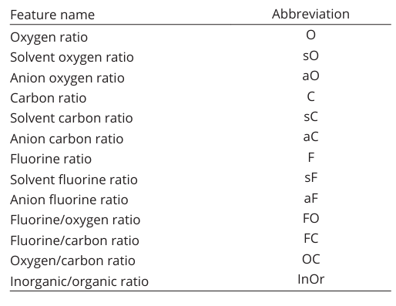
Background data processing
13 features based on composition
Concentration is important for electrolyte performance
InOr contains some (S,N,P…information)

Slide 5
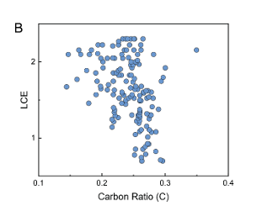
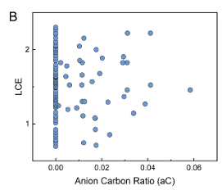
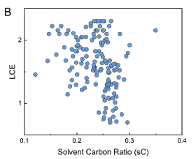
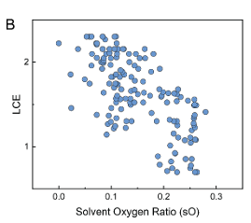
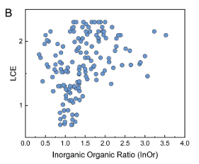
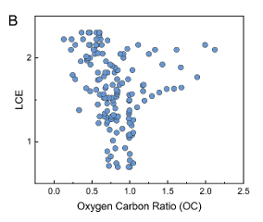
Background data processing
First step: Plot!
Many random distributed but dense part kind of linear
linear model is the simplest model
Linear regression model with multiple variables

Slide 6
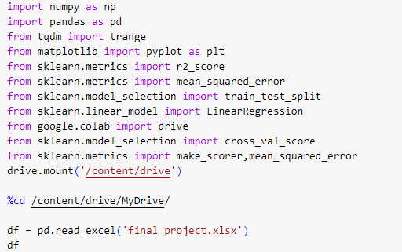
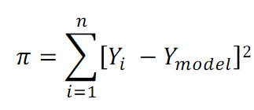
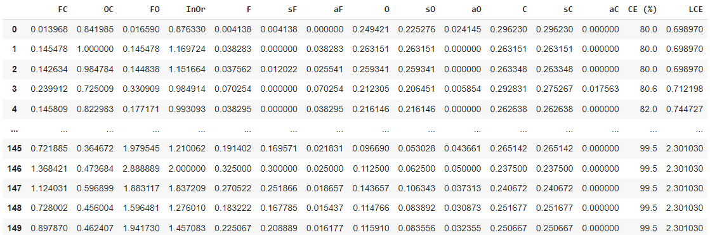
load dataset
Linear model
Y1
Y2
…
Y150
w1
w2
…
w13
FC1, OC1, …… , aC1
FC2, OC2, …… , aC2
……
FC150, OC150, …… ,aC150
=
Minimize least square cost
dependent
Independent features

Slide 7
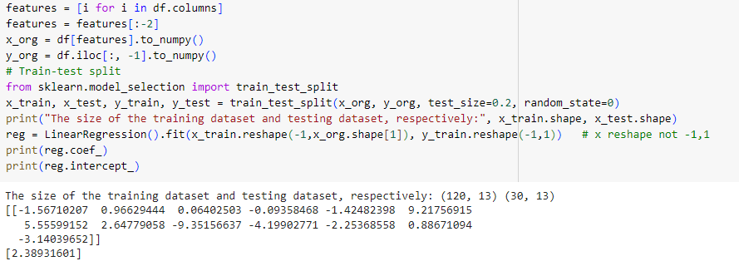
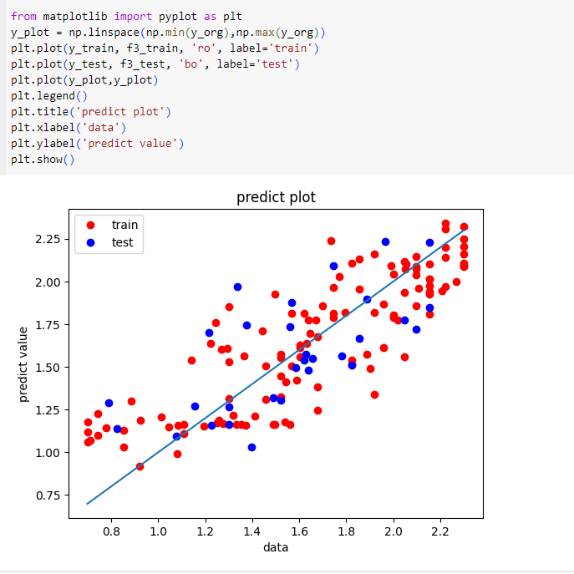
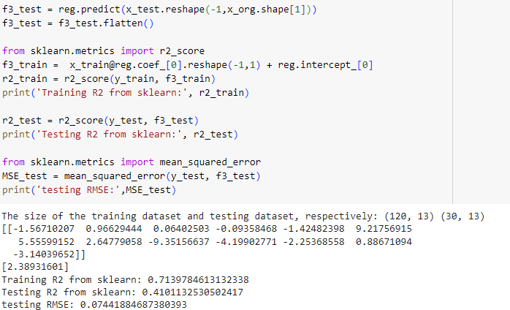
Perform linear regression
Train set: performing regression minimize cost function
Test set: unseen data, use to test model’s prediction accuracy for similar distribution unknown data
Seems good?

Slide 8
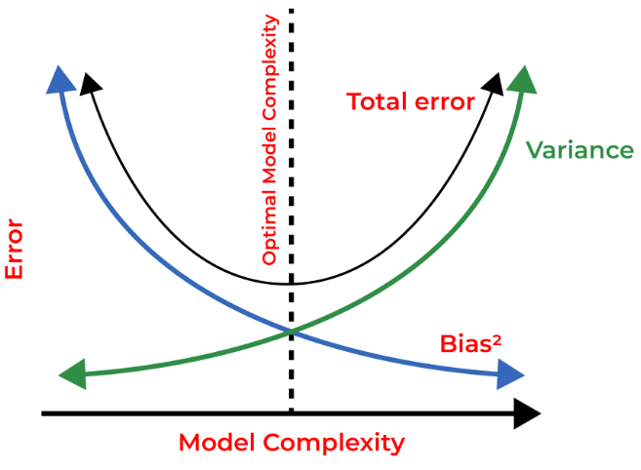
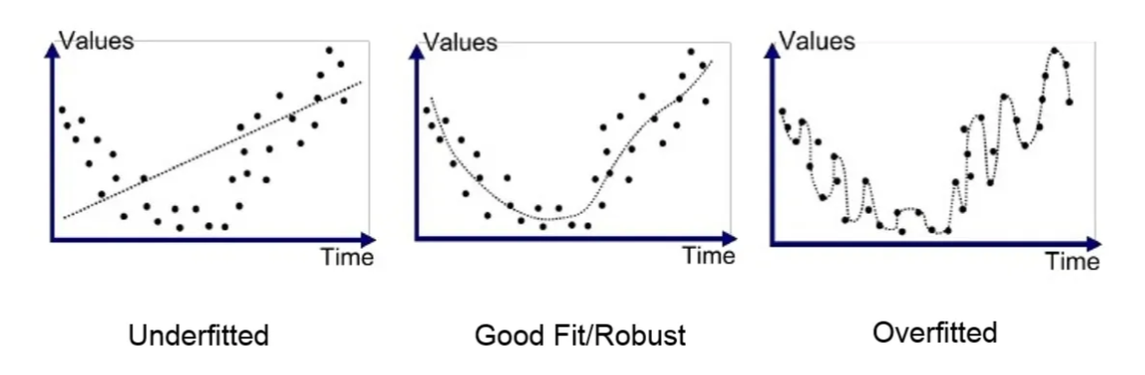
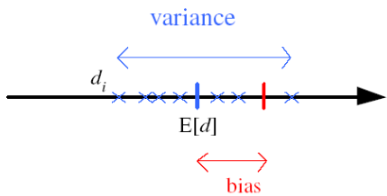

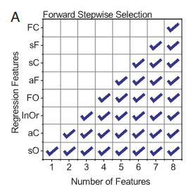
Many factors with small dataset (some specific formula have only one data points) tend to overfit
Select important features and leave out not important features
Determine Feature Importance using greedy strategy:
1)Regression use only one feature, choose the one with lowest square cost
2)Add another feature to the first, choose the one with lowest square cost as second important feature
…
1)Sequence features by importance
2)choose lowest error point
Catching random error’s pattern

Slide 9
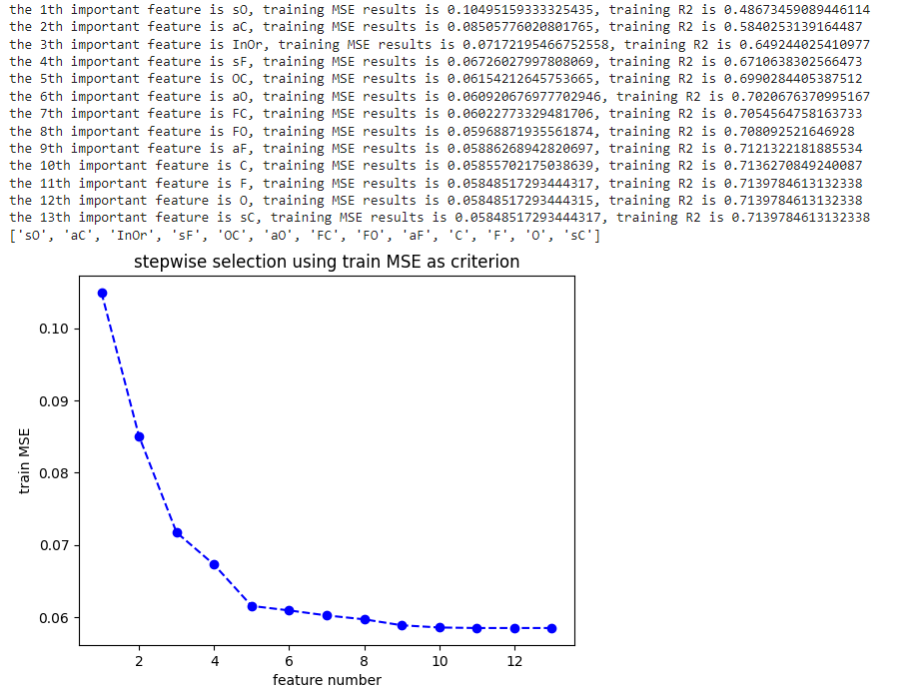
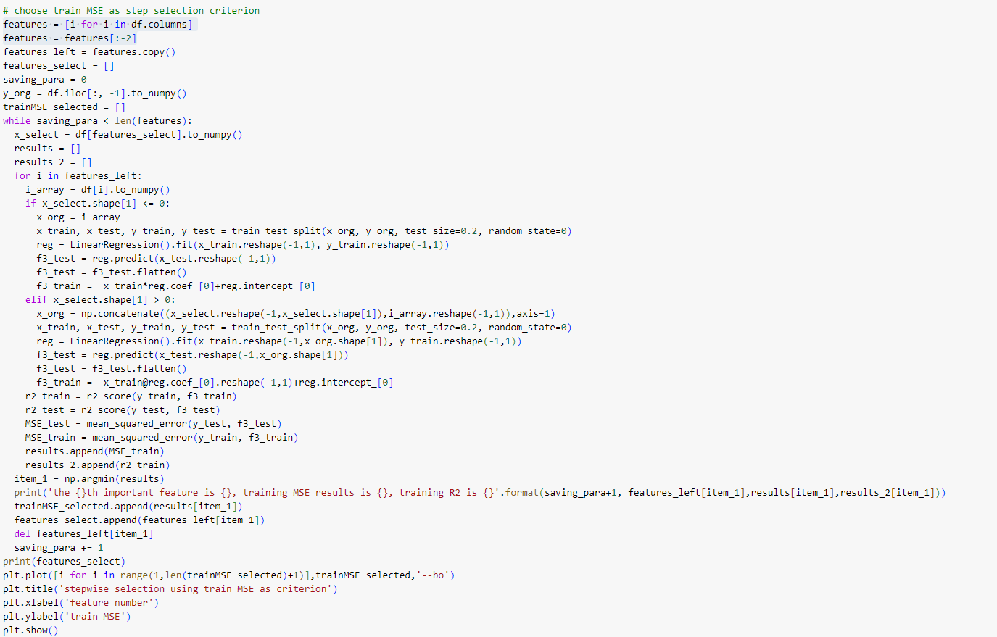
Stepwise feature selection
Paper result

Slide 10

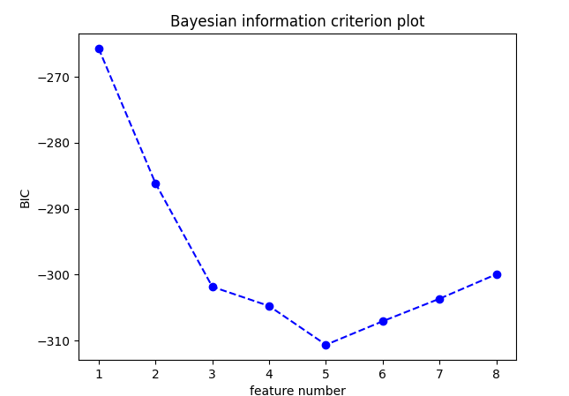
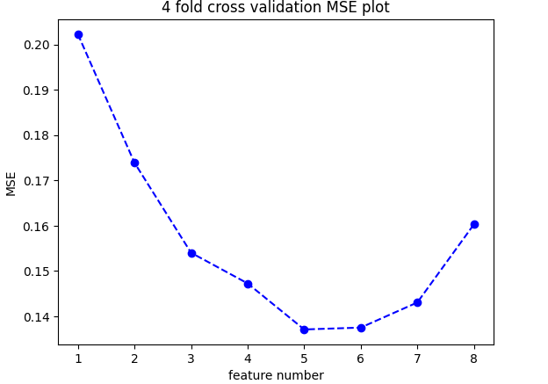
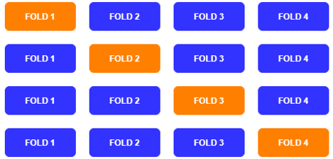
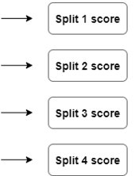

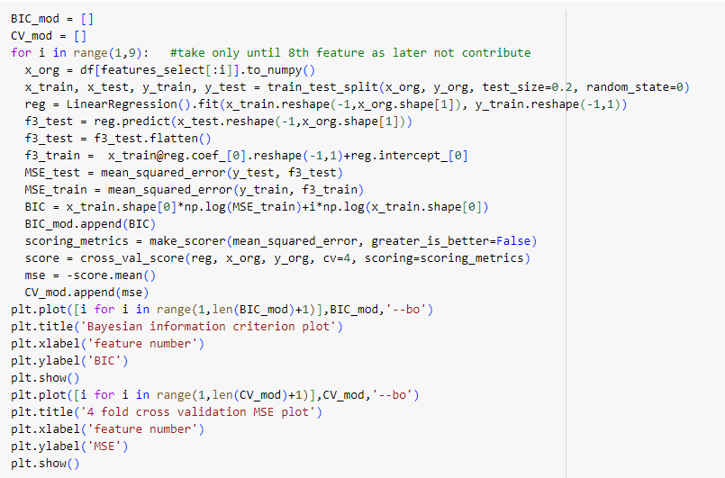
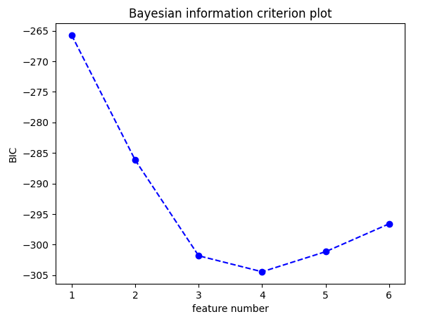
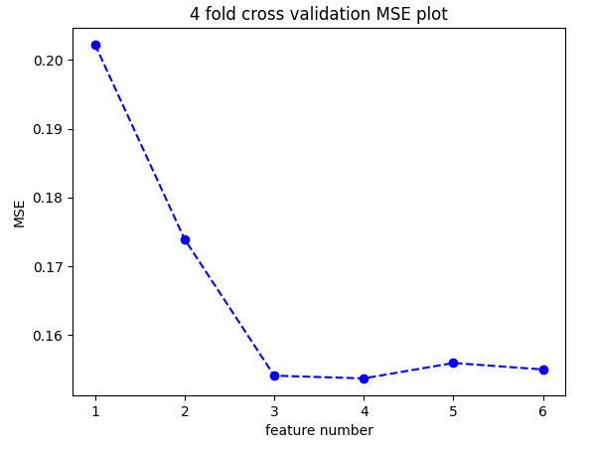
Choose model complexity
My results
Reference to 2 criterion
4-fold cross validation
2) Bayesian information criterion
Add a factor relate to number of parameters to cost function
Results use paper feature sequence

Slide 11
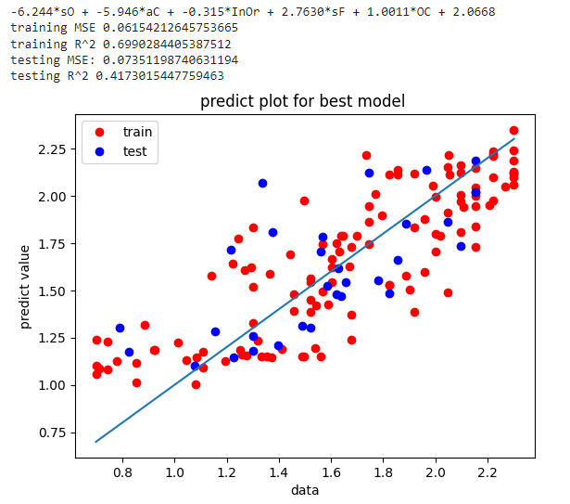
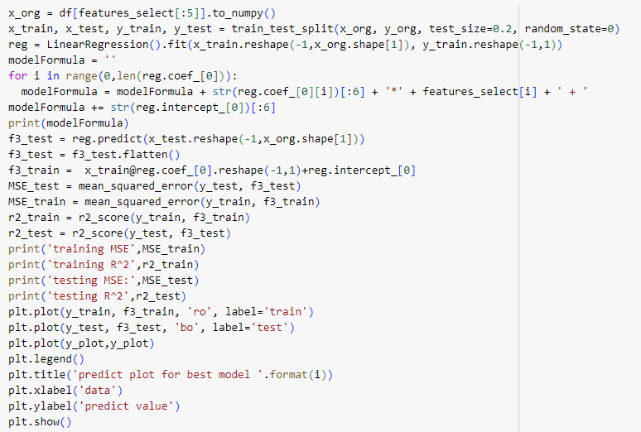
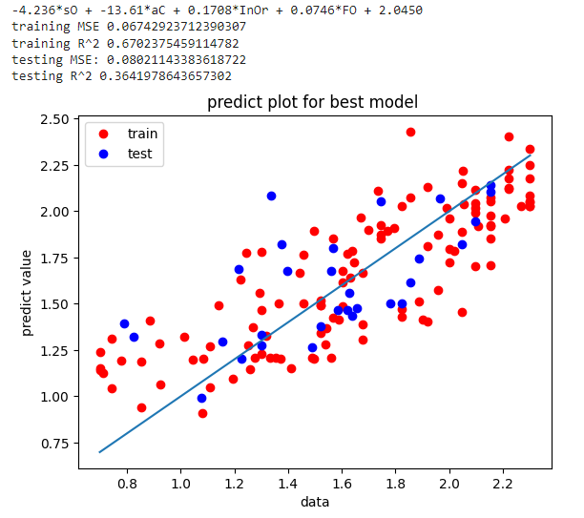
Best model for this dataset
Formulas
They use random forest model get similar testing MSE

Slide 12
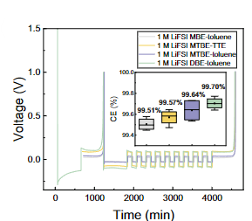
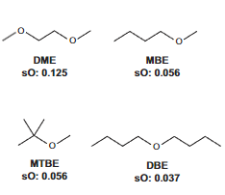
Experiment results
Solvent oxygen ratio
sO is most important feature, and coefficient is negative
Further study
Have a larger dataset
Control experiment condition like current density, electrolyte amount
3) Include more features from electrolyte formula (use molecule SMILES as input)

Slide 13
References
[1] Kim S. C., Oyakhire S.T., Athanitis C. et al. Data-driven electrolyte design for lithium metal anodes. PNAS(2023),120 (10) e2214357120
[2] Cosma Shalizi ‘Lecture 21: Model Selection’ 12:14 Friday 13th November, 2015
[3] Xiao, J., Li, Q., Bi, Y. et al. Understanding and applying coulombic efficiency in lithium metal batteries. Nat Energy 5, 561–568 (2020).
[4] Huang F., Ma G. Wen. Z. et al. Enhancing metallic lithium battery performance by tuning the electrolyte solution structure. Journal of material chemistry A, 4 (2018)

Slide 14
Thank you!

